Slide 1

1903299 cmp202
assignment presentation

Slide 2


Purpose
Dictionary style password cracker

Slide 3

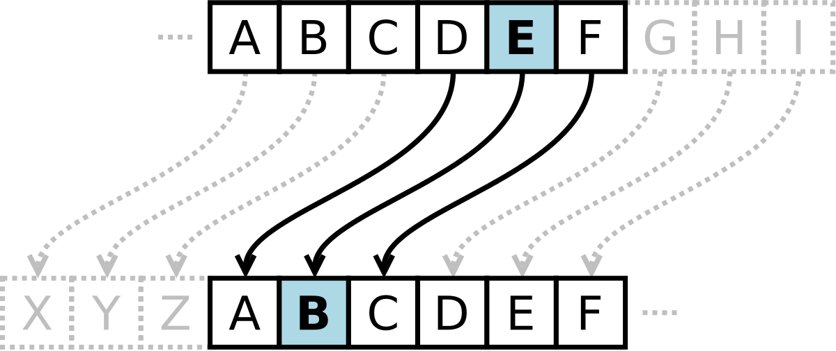
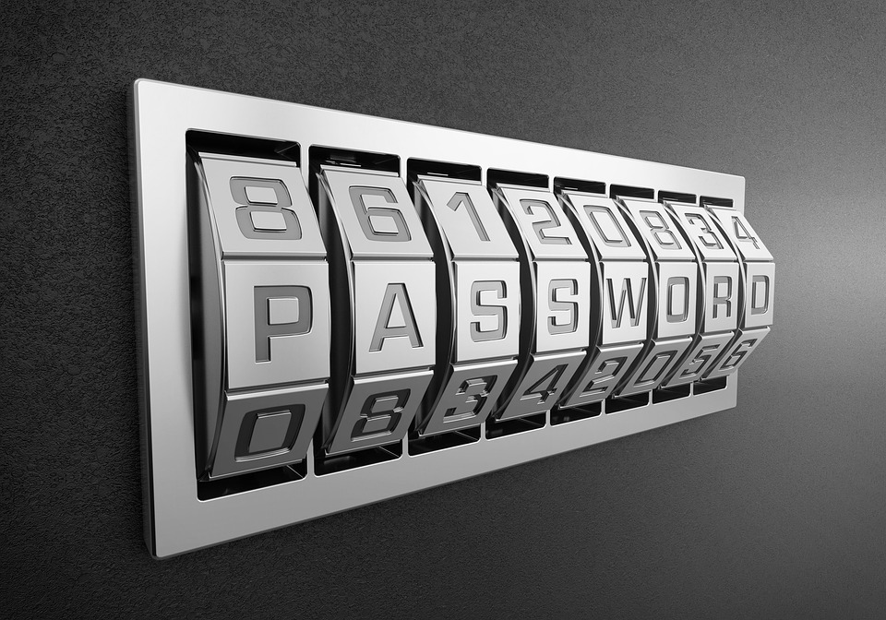
Structure
The main work flow of the program

Slide 4
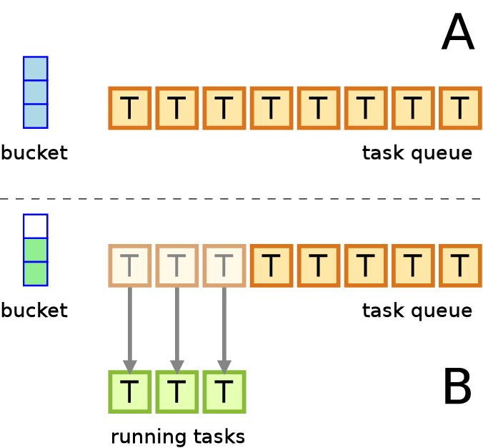

Parallel parts
Manager function
Consumer function

Slide 5
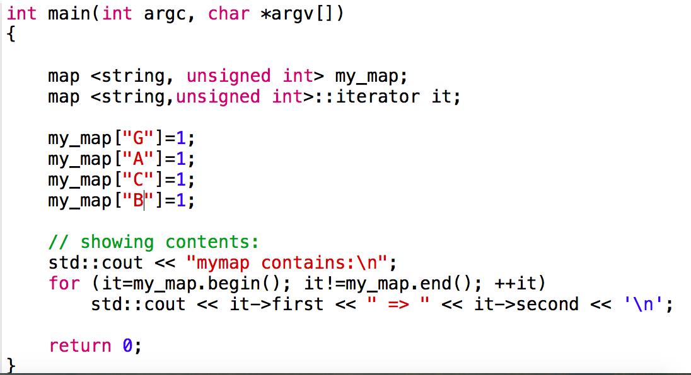
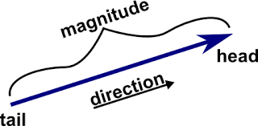

Other structures used
Unordered maps
Vectors

Slide 6
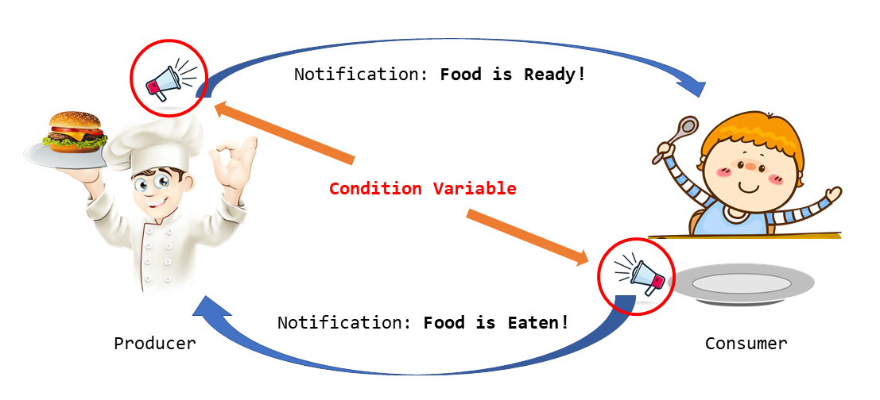
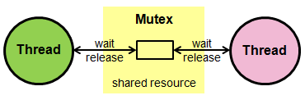
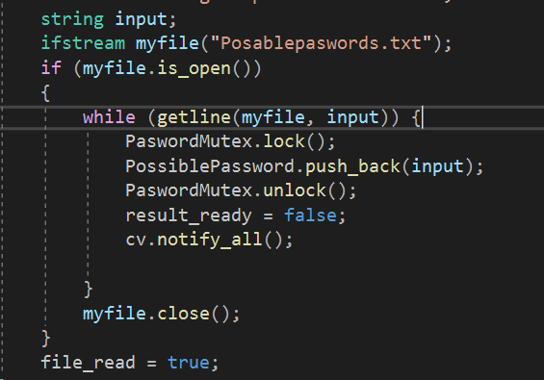
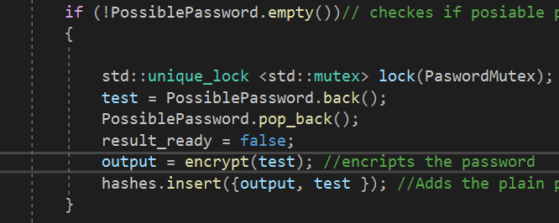
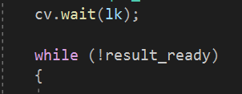
Thread Safety
Elements used mutexs and condition variables

Slide 7
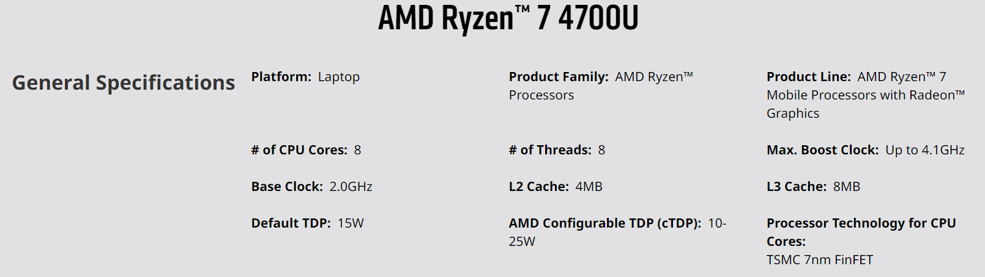
CPU Used
The built in CPU for my laptop

Slide 8
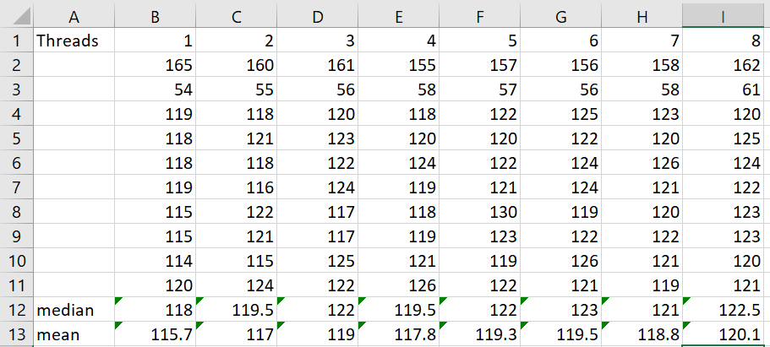
Results raw

Slide 9
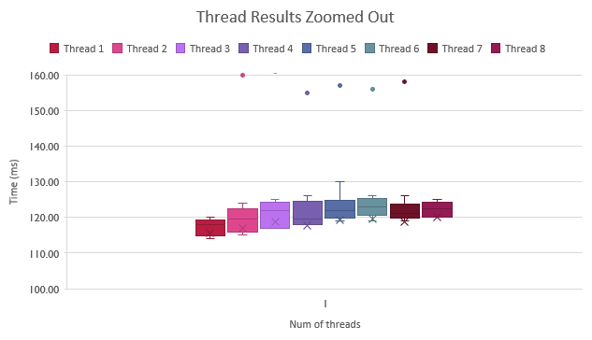
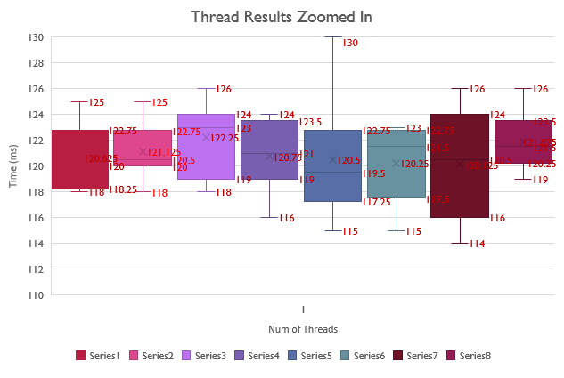
Results graphs

Slide 10
Results graph 2

Slide 11
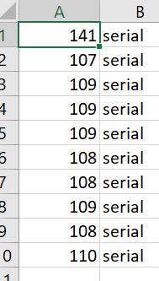
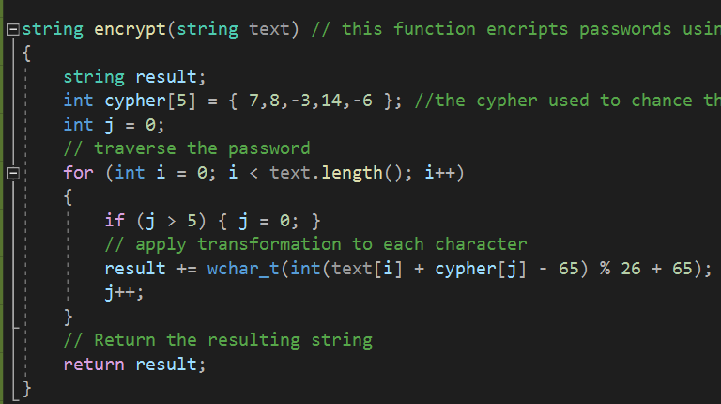
Explanation of results
There are 2 possibilities for why these results are like this.
the problem is to simple.
Only one or two threads are running at a time.

Slide 12

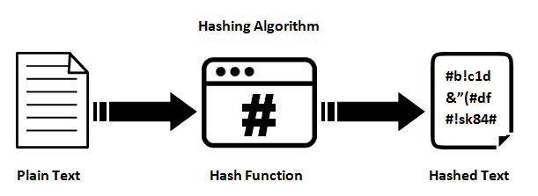

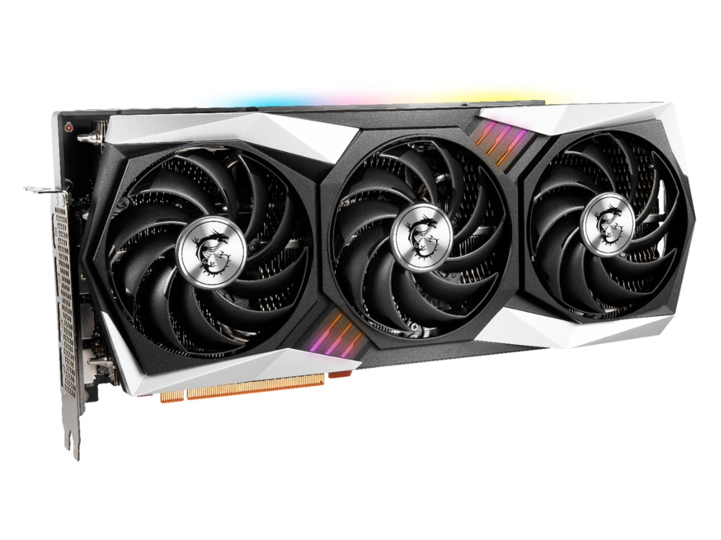
Evaluation
The are better ways and things that this system could be used for.

Slide 13

Thank you

